Slide 1
Solving Substitution Ciphers with Genetic Algorithms
Ladislav Šulák (laco.sulak@gmail.com)
Krisztian Benko (kristianbnk@gmail.com)
Home university: Brno University of Technology, Faculty of Information Technology (Czech Republic, but we both are from Slovak Republic)

Slide 2
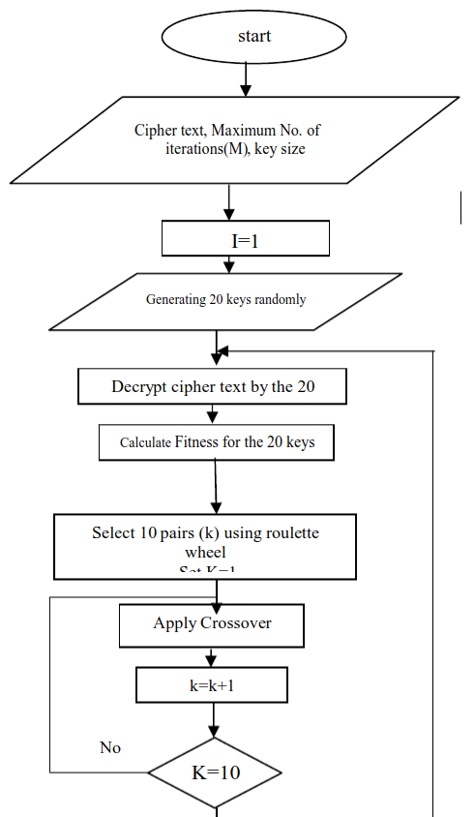
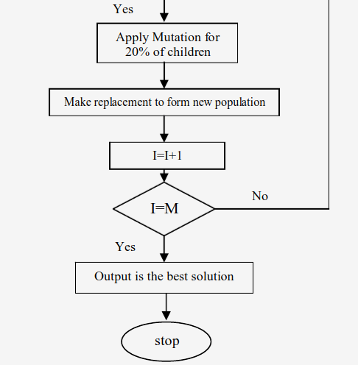
Algorithm

Slide 3
Key Lengths, Initialization
* Key Lengths
- possible lengths are chosen
– based on repeating part of substrings in encrypted text
* Initialization
- number of members in population is defined at the start
- population is created according to algorithm’s properties

Slide 4
Roulette wheel
* After the fitness value is calculated for every key, tuples are made by roulette wheel, which decide according to fitness value, which keys will be chosen

Slide 5
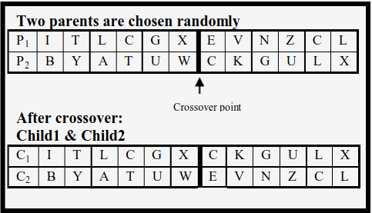
Crossover
* Two mating chromosomes are being cut by one-point crossover
* Strings were converted to binary representation for better results

Slide 6
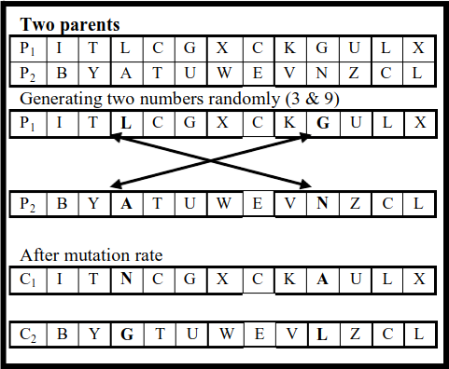
Mutation
* Prevention of being trapped in local minimum

Slide 7
Fitness function
* Fitness value of key is given by:
  - PyEnchant library - check if word belongs to language
  - Markov classifier model - if PyEnchant is not successful, this model is used, which is based on using digrams and trigrams
                https://github.com/exp0se/dga_detector

Slide 8
Results
Time | 6 min | 22 min | 33 min | 51 min
Size of Key | 3 bytes | 60 bytes | 7 bytes | 10 bytes
Size of Encrypted Text | 40 bytes | 170 bytes | 60 bytes | 183 bytes
Size of population | 40 | 40 | 40 | 40
Num of generations | 160 | 160 | 300 | 300

Slide 9
Improvements
* Roulette wheel – would be maybe better to create less pairs or at all do not use roulette, but tournament selection
* Crossover – could be over more points in string (two or three pointed), so we could get better varations

Slide 10
References
A Cryptanalytic Attack on Vigenère Cipher Using Genetic Algorithm
  * www.researchgate.net/publication/261451438_A_cryptanalytic_attack_on_Vigenere_cipher_using_genetic_algorithm
Genetic algorithm implementation is based on:
* materials from Computational Intelligence course from TEI
* http://www.obitko.com/tutorials/genetic-algorithms/ga-basic-description.php
* https://github.com/rodhilton/Geneticrypt
Markov Model classifier (gibberish_detector) is based on:
* https://github.com/exp0se/dga_detector
Other materials:
* [1996] The Applications of Genetic Algorithms in Cryptanalysis by A. J. Bagnall
* [2003] Solving Substitution Ciphers with Genetics Algorithm by Joe Gester
* [2008] Cryptoanalysis using genetic algorithms by P. Bergmann, Karel & Scheidler, Renate & Jacob, Christian
* [2008] Applying Genetic Algorithms for Searching KeySpace of Polyalphabetic Substitution Ciphers
by Ragheb Toemeh and Subbanagounder Arumugam
* [2011] A cryptanalytic attack on Vigenère cipher using genetic algorithm
by Omran, Safaa & Al-Khalid, A.S. & Alsaady, Dalal

